Slide 1
₹
AI Finance Assistant
Your smart companion for loans, EMI & investments
Group 4:-
Bhavika (2520982541)
Deeksha(2520982551)
Udita (2520982749)
Prachi (2520982677)
Simple · Accurate · User-Friendly

Slide 2
What We Do
An intelligent assistant that simplifies your financial decisions
🏦 Loan Check
📊 EMI Calculator
📈 Investments
Instant eligibility
based on salary & age
Monthly payment &
total interest summary
Personalised advice
by risk appetite
AI-Powered • Real-Time Calculations • Easy to Use

Slide 3
Problem statement
Financial decisions like loans and investments are complex and
overwhelming for most users. People lack quick, personalized
financial guidance when they need it most. Manual calculations for
EMI and loan eligibility are time-consuming and prone to errors.
The challenge
There is no unified platform that provides comprehensive financial assistance. Users must navigate multiple tools and resources to get answers about loans, investments, and financial planning, leading to confusion and poor decision-making.

Slide 4
⭐ AI & NLP in Finance
Artificial Intelligence and Natural Language Processing are transforming how we interact with financial services. These technologies enable automated decision-making and intuitive communication between users and financial systems.
🤖 Artificial intelligence
📱 Chatbots & Support
Automates complex financial decision-making processes, enabling faster and more accurate outcomes.
AI-powered chatbots provide instant customer support and personalized financial guidance 24/7.
🔒 NLP
📊 Fraud detection
Understands user queries in human language, making financial tools accessible to everyone.
Machine learning algorithms detect suspicious patterns and protect users from financial fraud.

Slide 5
💡 Dialogflow Architecuture
The AI-powered finance assistant uses Dialogflow's NLP engine to process user queries. When a user sends a message, Dialogflow analyzes the input, identifies the intent (loan eligibility, EMI calculation, or investment advice), extracts relevant entities (salary, loan amount, risk level), and generates an appropriate response.
👤 User input
🤖 NLP Processing
👤 Intent Recognition
🤖 Response Output

Slide 6
💬 How It Works
A simple 3-step conversation to get your financial answers
1
2
3
Choose a Service
Provide Details
Get Your Answer
Select Loan Check,
EMI Calculator, or
Investment Advice
Answer a few guided
questions — salary, loan
amount, risk level, etc.
Receive clear results,
calculations, and
tailored suggestions

Slide 7
🏦 Loan Eligibility Check
We assess your profile instantly using three key parameters
Eligibility Criteria
Possible Outcomes
💰 Monthly salary ≥ ₹20,000
✅ You are eligible for the loan
All three conditions are met — proceed with the application.
🎂 Age between 21 – 60 years
💼 Must be currently employed
❌ Not eligible at this time
One or more criteria not satisfied — we explain why.
📋 Salaried or Self-employed

Slide 8
📊 EMI Calculator
Calculate EMI (Equated Monthly Installment) to help users understand their monthly loan repayment obligations quickly and accurately.
EMI Formula
Monthly EMI
₹23,072
EMI = [ P × R × (1+R)ᴺ ] ÷ [ (1+R)ᴺ – 1 ]
P — Principal loan amount
Total Payment
₹5,53,728
R — Monthly rate = Annual Rate ÷ 12 ÷ 100
N — Tenure in months
Total Interest
₹53,728
Example: ₹5L loan @ 10% for 2 years

Slide 9
📈 Investment Advice
Tailored suggestions based on your comfort with risk
🟢 Low Risk
Fixed Deposits · Government Bonds
Stable, guaranteed returns with capital protection. Ideal for conservative savers.
🟡 Medium Risk
Mutual Funds · SIPs
Market-linked growth with diversification. Best for steady, long-term wealth building.
🔴 High Risk
Stocks · Cryptocurrency
High return potential with significant volatility. Suited for risk-tolerant investors.

Slide 10
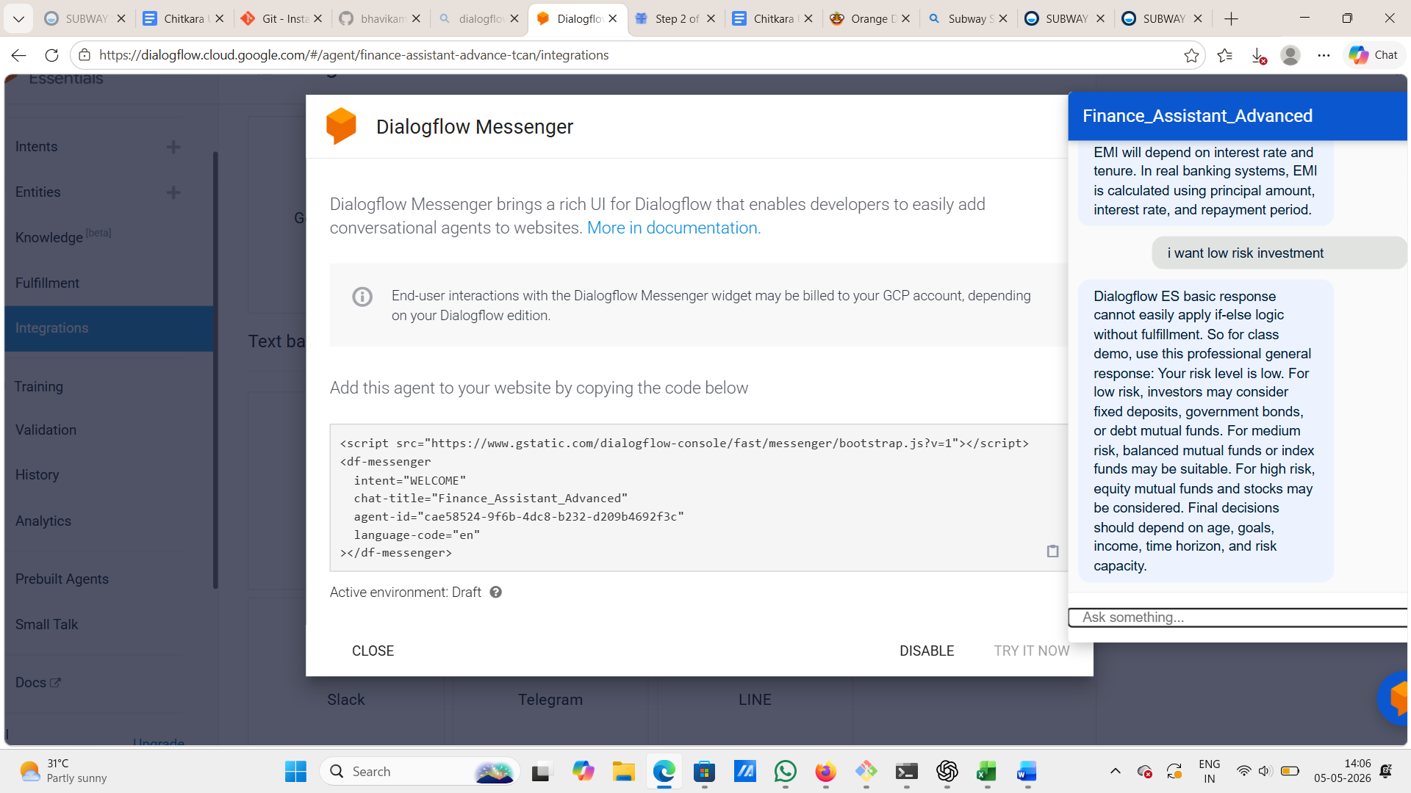
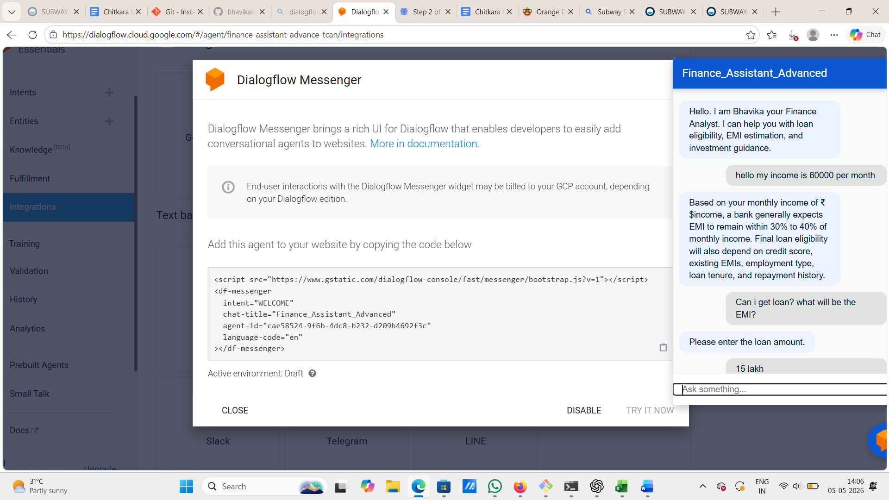
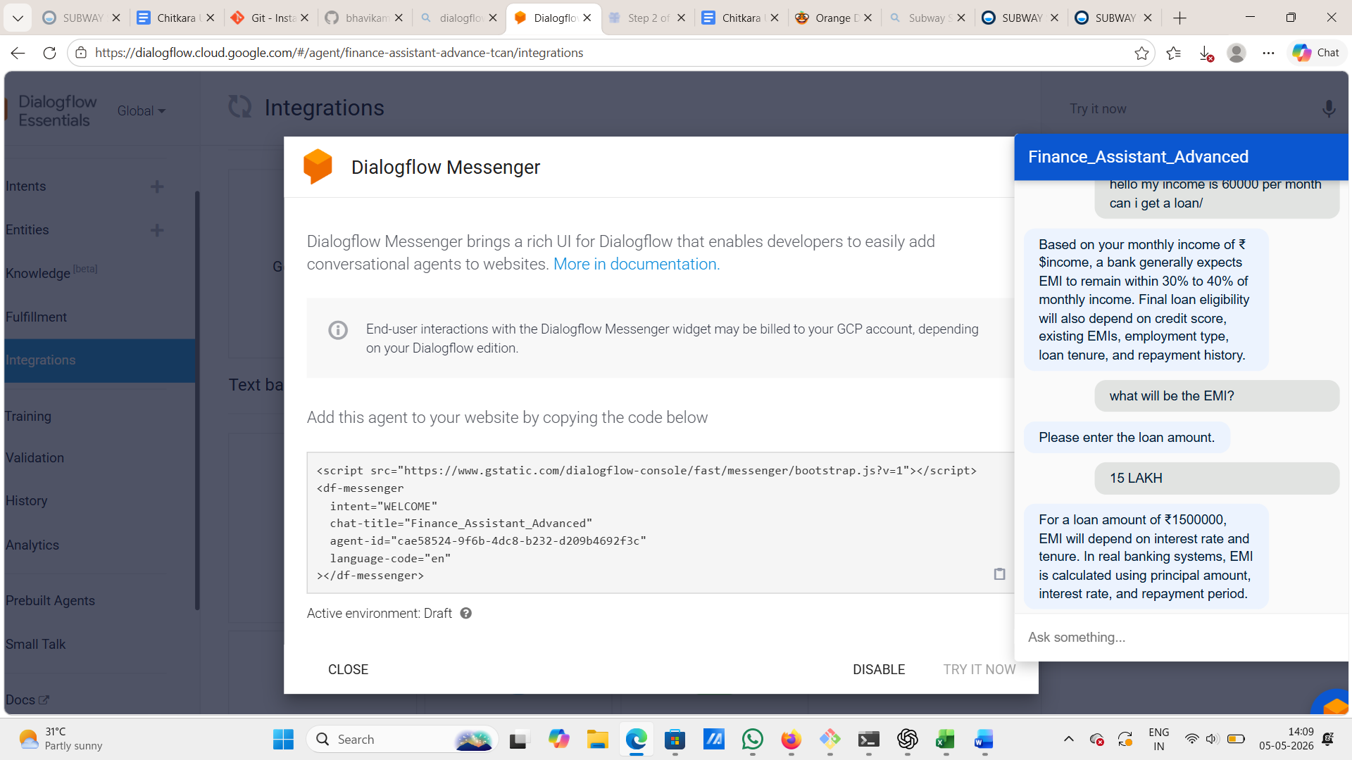
💡Screenshots & Outputs
See how the AI Finance Assistant responds in real conversation

Slide 11
⭐ Key Features
🤖 AI-Powered
📱 Conversational UI
✅ Input Validation
Smart responses and real-time calculations driven by intelligent logic
Chat naturally — no forms, no complex menus, just plain language
Handles missing or incorrect inputs gracefully with helpful prompts
🔒 Private & Safe
📊 Detailed Output
⚡ Instant Results
No financial data stored — your information stays with you
Get EMI, total interest, and payment breakdown in one response
Receive answers in seconds — available 24×7, whenever you need

Slide 12
GitHub Repository
Access the complete project code and resources for the AI-Powered Finance Assistant. The repository includes all Dialogflow export files, configuration settings, and sample datasets used for training the chatbot intents.
Project code :-
Full source code available on GitHub. Clone or fork the repository to explore the implementation details and customize for your needs.
https://github.com/deeksha29-bawa/ai-finance-expense-automation-system-
https://github.com/bhavikamadaan8-sketch/ai-finance-expense-automation-system
AI Finance Assistant • Simple · Accurate · User-Friendly

Slide 13
🙏
Thank You!
We appreciate your time and attention
Let us know if you need help with anything else 💬
AI Finance Assistant • Simple · Accurate · User-Friendly

